Slide 1
Overview of presentation
Food safety
Implications of unsafe food
How to eliminate P/C/B hazards
Food hygiene/Temp Control/Pest Control/Personal hygiene/Food storage/Cleaning/Allergens 21
AI in Food Processing
Food Safety Standards 21-30
Certifications – Food Safety
FSMS/ ISO22000/HACCP/TACCP/HARPC
BRC/FSSC/Kosher/HALAL
Certification Agencies in India (HACCP/FSMS) 30-40
Principles of HACCP
Elements of ISO 22000:2018 60
Q/A

Slide 2
FOOD PROCESSING
FBO
Consumers
Processing
Safety
Packaging
Sensory quality
Storage
Nutrition
Distribution
Shelf-life
Legal Compliance is must

Slide 3
Who is at risk?
Infants
Toddlers
Elderly
Pregnant women
Immunocompromised
Taking specific medications

Slide 4

FOOD SAFETY
Safety – prevention / protection from illness / sickness / injury,
Food safety- illness/sickness arising from consumption of food
Foodborne illness - Caused by eating contaminated foods or beverages
Lack of safety precautions / procedures can lead to Hazards (Hazard: source of illness, injury, sickness..)
Understanding the hazards and methods for their control is important for food safety
- in -

Slide 5
HAZARDOUS SUBSTANCES
Physical
Hair
Pin
Stone
Glass
Metal piece
Jewellery
Buttons
Safety pins
Nut/bolt/washer
Eqpt. part
Chemical
Detergent
Pesticides
Water pollution
Air pollution
Lubricant oil
Heavy metals
Toxins
Veterinary drugs
Biological
Insects
Rodents
Flies
Excreta of …
Microorganisms
Bacteria
Fungus
Virus
eliminate the hazards – reduce the risks

Slide 6
Food Poisoning
Type of Foods that are considered “High Risk” in terms of food poisoning
High protein foods such as meat and poultry
Dairy products
Eggs and egg products
Soups, stews, stocks
Rice
Any product that requires refrigeration to prevent it from spoiling
Bacteria are the major cause of food poisoning. Illness is caused by the presence of specific bacteria or their toxins, either in or on food.
Symptoms of Food Poisoning
Vomiting
Diarrhea
Nausea
Fever

Slide 7


Slide 8
Methods to Prevent / eliminate hazards
Physical
Cleaning
Magnetic separator
Maintenance of eqpt./ building /utilities/instruments
Hair nets, masks, gloves, uniform
No jewellery
Chemical
Cleaning/washing, sanitizing
Check quality of water
GAP
Labelled and designated storage of chemicals
Ventilation
Air curtains
Biological
Building
Pest control
Fly killers
Rat baits
Time
Temperature
Acidity
Oxygen
Moisture
PRP/oPRP/CCPs

Slide 9
General principles of Food Hygiene
Primary production
Establishment: design and facilities
Control of operation
Establishment: maintenance and sanitation
Establishment: personal hygiene
Transportation
Product information and consumer awareness
Training

Slide 10
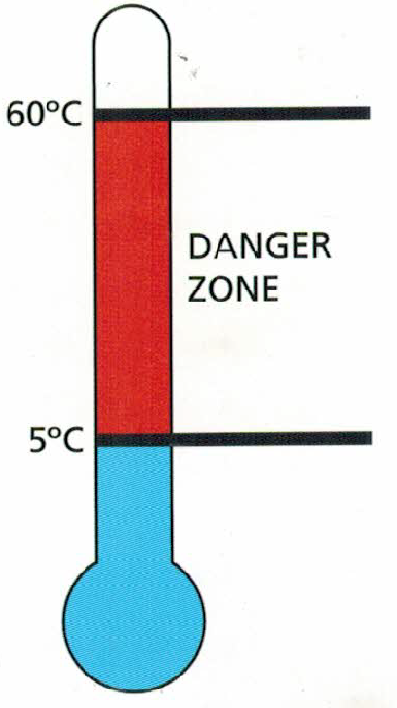
Temperature Control
Temperature
Temperature is the main method used to control the level of bacteria in foods.
Danger Zone
The temperature range within which the bacteria grows rapidly is between 5ºC and 60ºC. This is known as the danger zone. Below 5oC, bacteria grow more slowly and above 60oC, bacteria start to die.

Slide 11
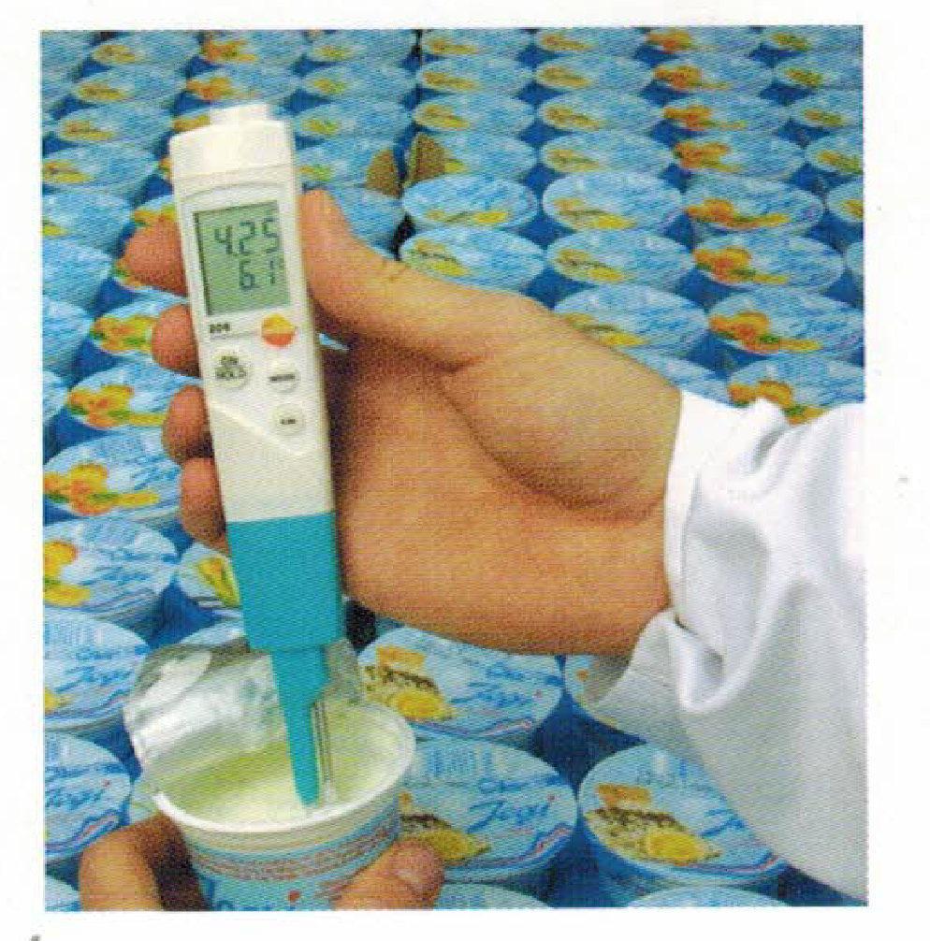
Temperature Control
Temperature requirements
Cold food must be kept at less than 5ºC
Frozen food shall remain hard frozen and at less than -18ºC.
Cooked food should be heated to a temperature of over 75ºC.
During cooling, food products must be cooled from 60ºC to 21ºC within 2 hours and from 21ºC to less than 5ºC within a further 4 hours.
Keep Hot Food Hot and Cold Food Cold

Slide 12
Pest Control
Pest control to be undertaken by licensed agency.
Employees should not interfere with pest control activity.
Do not touch rat bait stations or any other pest control device.
Be aware of the pests and record any sighting of the pests like cockroaches, rodents and mice, flies, fruit flies, moths, ants etc.
Sometimes actual pests may not be visible, but evidence of their presence in the form of droppings, excreta, broken packaging etc. may be noticed.
Do not allow entry and breeding of pests in processing and storage areas.

Slide 13
PERSONAL HYGIENE (Food handlers, workers)
Food handlers must be clean and tidy and must wear a clean uniform, protective clothing and head wear
Hair – clean, tied back and covered
Disposable gloves to handle high risk foods
Watches, earrings, nose rings/pins, rings, chains, necklaces not allowed.
Fingernails short and clean
Hand wash stations to be provided with soap, paper towel/dryer and hot water.
When to wash hands
Wash hands after
Handling garbage
Handling raw food
Using the toilet
Sneezing, coughing and using a handkerchief or tissue
Carrying out cleaning duties
Eating or smoking
Wash hands before
Before starting any food handling activities
Workers suffering from diarrhea, vomiting, flu, fever, etc. not permitted to work

Slide 14
Food Storage
Dry
Cool dry and well-lit rooms.
Product shall be stored off the floor and away from walls.
Rotate stock – First In First out
Ensure shelving is cleaned regularly
Cold rooms and Fridges
Ensure temperature is less than 5ºC
Store raw products beneath cooked or ‘ready to eat’ foods
Cover, label and date all foods.
Keep cold rooms, fridges clean
Freezers
Ensure temperature is less than -18ºC
Cover, label and date all foods
Defrost and clean freezer regularly

Slide 15
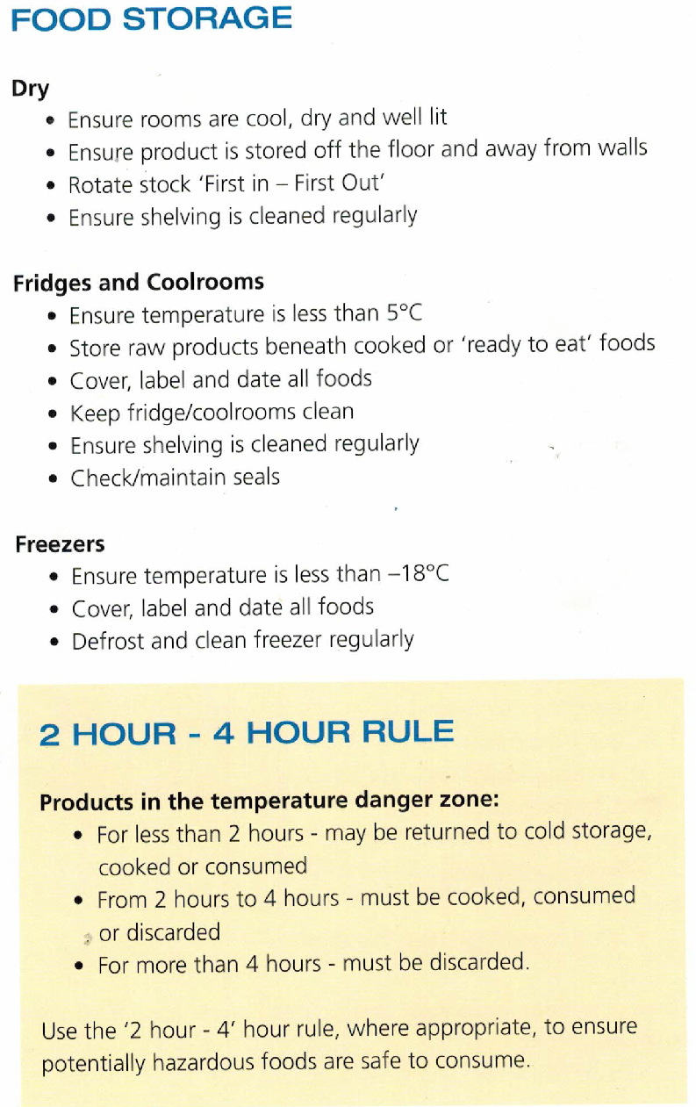
Food Storage
2 – HOUR – 4 HOUR RULE
Products in the temperature danger zone
For less than 2 hours – may be returned to cold storage, cooked or consumed.
From 2 hours to 4 hours – must be cooked, consumed or discarded.
For more than 4 hours – must be discarded.

Slide 16
CLEANING
All premises need to be kept clean and tidy
Clean to remove soil and dirt and sanitise to kill bacteria.
Cleaning procedures should be available describing how to clean the equipment and the structure of the facility.
Cleaning chemicals should be stored away from work areas and from food and packaging storage areas.
Record all cleaning activities in the cleaning report.
Keep surfaces in good condition so they are easy to clean
Fix broken tiles
Avoid wooden shelves
Repair damaged junction seals
Repair and eliminate rust on any surface
Cleaning will ensure
Cross contamination is reduced and minimised
Bacteria does not grow on the surfaces
Quality of the product or process is of high standard

Slide 17
Waste disposal
Waste is an easy breeding ground for bacteria and pests
Waste shall not be allowed to stay inside the food preparation premises.
It shall be routinely removed and disposed of properly, following the norms

Slide 18
Allergens
Following foods are allergic and may not be suitable for many individuals. Allergic foods may cause mild to severe sickness.
Peanuts and their products
Tree nuts and their products
Shell fish, crustacean and their products
Finned fish and their products
Milk and milk products
Eggs and egg products
Sesame and sesame products
Cereals containing gluten and their products (Wheat, rye, barley, oats and their products)
Soybeans and their products
Added sulphites in concentrations of 10 ppm ( 10 mg/kg) or more
The allergic reaction to food is caused by a protein in the food that the immune system mistakenly believes is harmful.

Slide 19
The 14 allergens are: celery, cereals containing gluten (such as wheat, barley and oats), crustaceans (such as prawns, crabs and lobsters), eggs, fish, lupin, milk, molluscs (such as mussels and oysters), mustard, peanuts, sesame, soybeans, sulphur dioxide and sulphites (if they are at a concentration of more than ten parts per million) and tree nuts (such as almonds, hazelnuts, walnuts, brazil nuts, cashews, pecans, pistachios and macadamia nuts).
This also applies to additives, processing aids and any other substances which are present in the final product.

Slide 20
Food Hygiene can prevent illness

Slide 21
Applications of Artificial Intelligence in the Food Industry
Sorting Products and Packages and Products
Food Safety Compliance
Maintaining Cleanliness
Developing Products
Assisting Customers With Decision Making

Slide 22




Eliminate Hazards Safe Food Less Food Loss Healthy Nation
Thank you

Slide 23
FOOD SAFETY STANDARDS
Microbiological contamination (pathogens, coliforms, TPC, Yeasts and Molds)
metal contaminants (heavy metals)
mycotoxins
residues (pesticide residues)
Food Safety Standards Authority of India

Slide 24
Microbiological analysis - pathogens
Vibrio cholerae | IS 5887 (Part 5): 1976 APHA (4th Edition) Chapter 40-40.5, FDA-BAM Chapter 9 | Detection/25 ml or 25 g
Vibrio parahaemolyticus | IS 5887 (Part 5): 1976 FDA-BAM Chapter 9 | Detection/25 ml or 25 g
Listeria Species | IS 14988 (Part 1 & 2): 2001 FDA BAM Chapter 10, APHA (4th Edition) Chapter 36-36.5 | Qualitative 1g, 25g.
Test For Commercial Sterility | APHA (4th Edition) Chapter 61-61.51 | Qualitative (Pass/ Fail)

Slide 25
Contaminants, Toxins and Residues
Metal elements (in foods not specified) upper limit; FSSAI
Lead - 2.5 ppm
Copper - 30 ppm
Arsenic - 1.1 ppm
Tin - 250 ppm
Zinc - 50 ppm
Cadmium - 1.5 ppm
Mercury - 1.0 ppm
Methyl Mercury - 0.25 ppm (calculated as the element)
Chromium - Refined Sugar - 20 ppb
Nickel - 1.5 ppm
All hydrogenated, partially hydrogenated, inter-esterified vegetable oils and fats such as vanaspati, bakery and industrial margarine, bakery shortening

Slide 26
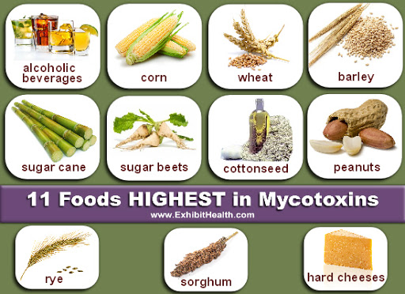
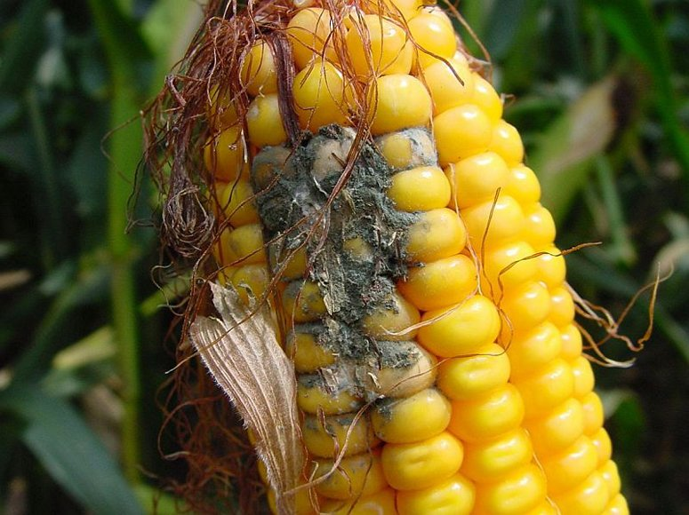

Slide 27
Regulatory limits of mycotoxins
Toxin | Article of food | Limit 𝞵g/kg (FSSAI)
Aflatoxin | Cereals, pulses and products | 15.0
 | Ready to eat products | 10.0
 | Oilseeds, nuts | 15.0
 | Spices | 30.0
Aflatoxin M1 | Milk | 0.5; 0.05 (EU)
Patulin | Apple juice | 50.0
Ochratoxin A | Wheat, barley and rye | 20.0
Deoxynivalenol | Wheat | 1000.0
US FDA and EU have more stricter regulatory requirements for mycotoxins.

Slide 28
Residues (Insecticides, Herbicides, Fungicides)
567 formulations of 272 insecticides - registered in India.
More than 150 combinations are also registered
Worldwide, more than 1200 active substances are registered for pesticides production. Pesticides can be classified into more than 100 classes/groups, for example, Carbamates, Triazines, Pyrethroids, Organophosphates, Organochlorines, Phenoxy alkane Pesticides, Pesticides based on glyphosate….
Organochlorines, organophosphates, carbamates and pyrethroids
Tolerance limits of the residues (insecticides, herbicides, fungicides) on crop, food commodities are prescribed under regulations. Also called MRLs

Slide 29
FSSAI Tolerance Limits - Residues
Name of the insecticide | Crop/commodity | Tolerance limit (mg/kg or ppm)
Aldrin, Dieldrin | Food grains | 0.01
 | Milled foodgrains | Nil
Fenitrothion | Food grains | 0.02
 | Milled foodgrains | 0.005

Slide 30
Methods to measure / analyse food safety parameters are also specified and the testing is to be in accordance with these prescribed test methods
Accredited Food testing laboratories

Slide 31

FOOD SAFETY MANAGEMENT SYSTEMS
Make food safe
PREVENT HEALTH HAZARDS
Reduce wastage of food
Improve compliance to regulations
Promote export

Slide 32
Management System
Management - the act of getting people together to accomplish desired goals and objectives using available resources efficiently and effectively. ..
People involved in production, processing, preparation, handling, storage, retail,… of food from farm to consumer (workers as well as management)
System - a set of principles or procedures according to which something is done; an organized scheme or method
How food is cultivated, harvested, transported, prepared, stored, moved, retailed, served…
Notes:
‹#›

Slide 33
ISO 22000 certification ISO 22000 is a Food Safety management System that can be applied to any organization in the food chain, farm to fork, irrespective of manufacturing or service industry involved in food and beverage service, food and beverage trading, food and beverage warehousing, food and beverage transportation and food packaging, involved in Agriculture, Aquaculture, Horticulture, Fruits and Vegetables, Dairy Products, Meat and Meat Products, Fish and Fishery products, Spices and Condiments, Nuts and Nut products, Cereals, Bakery and Confectionery, restaurants, Hotels, Fast Food Operations. ISO 22000 combines and supplements the core elements of ISO 9001 and HACCP to provide an effective framework for the development, implementation, monitoring and continual improvement of a documented FSMS.

Slide 34
What is HACCP?
HACCP is a tool for identifying what can go wrong to make food unsafe for human consumption and then deciding how it can be prevented.
Before HACCP is addressed, a pre-requisite programme must be in place covering the general principles of food hygiene.
HACCP is applicable to the identification of microbiological, chemical, physical and allergen hazards affecting the food safety.
HACCP must be applied to a specific process and product combination.
Types of HACCP Certification
Codex Alimentarius HACCP
Accredited HACCP (CAC RCP-1, 1969, Rev.3 2004)
HACCP as per IS 15000:1996
EU HACCP 2016/C278/01
Singapore HACCP requirements

Slide 35
Food Safety Standards Authority of India (FSSAI)
To provide assurance of food safety, Food businesses must implement an effective Food Safety Management System (FSMS) based on Hazard Analysis and Critical Control Point (HACCP) and suitable pre- requisite programmes by actively controlling hazards throughout the food chain starting from food production till final consumption.
As per the condition of license under FSS (Licensing & Registration of Food Businesses) Regulations 2011, every food business operator (FBO) applying for licensing must have a documented FSMS plan and comply with schedule 4 of this regulation. Schedule 4 introduces the concept of FSMS based on implementation of Good Manufacturing Practices (GMP) and Good Hygiene Practices (GHP) by food businesses
FSSAI recommends that all licensed food businesses must have at least one trained and certified Food Safety Supervisor under FoSTaC for every 25 food handlers in each premise.

Slide 36
VACCP (Vulnerability Assessment Critical Control Points) counterfeiting, adulteration, smuggling, stolen goods, dilution and mislabelling. TACCP (Threat Assessment Critical Control Points) intentional contamination of food products, sabotage of the supply chain, and using food or drink items for terrorism or criminal purposes. HARPC (Hazard Analysis & Risk-Based Preventive Controls)

Slide 37
Categories of Standards
- Specification – absolute requirements of a product
Codes of Practice – recommended sound good practice
Methods - measurement / testing
Guidelines - prescriptive, indicates current thinking & practice among experts in a field

Slide 38
Food Safety Certifications Export - International
International Featured Standard (IFS) Food Certification
BRC-Food Certification
BRC Packaging Certification
FSSC 22000 Certification
BRC Food Safety Culture Module
BRC Agents and Brokers
BRC Storage and Distribution
FSSC 22000 – Food packaging manufacturing

Slide 39


Specific certifications
Kosher Certification
Jewish religious based product
specifications
Halal certification
Products are permissible under
Islamic law

Slide 40
Name of the Certification Bodies (FSMS/HACCP)
Bureau Veritas (India) Ltd.
TQ Cert Services Pvt Ltd.
TUV SUD South Asia Pvt ltd
TUV India Pvt Ltd
IRCLASS Systems and Solutions Pvt Ltd.
INDOCERT
SGS India Pvt ltd
DNV GL Business Assurance India Pvt Ltd
One cert International pvt Ltd.
Intertek India Pvt Ltd
Vexil Business Process Services Pvt Ltd.
BSI Group India Pvt Ltd.
MS certification Services Pvt Ltd.
COTECNA Inspection India Pvt Ltd
Standards Organisation of Nigeria
Integrated Quality Certification Pvt Ltd.
Prime Certification &Inspection LLC

Slide 41
Principles of HACCP
Conduct a hazard analysis.
Determine the critical control points (CCPs)
Establish critical limit(s).
Establish a system to monitor control of the CCP.
Establish the corrective action to be taken when monitoring indicates that a particular CCP is not under control.
Establish procedures for verification to confirm that the HACCP system is working effectively.
Establish documentation concerning all procedures and records appropriate to these principles and their application.
Covered under Clauses 7.4 to 7.9 of ISO 22000:2018

Slide 42
Elements of ISO 22000:2005
ISO 22000:2005 has five main Clauses
Clause 4: Food Safety Management System
Clause 5: Management Responsibility
Clause 6: Resource Management
Clause 7: Planning and realization of safe products(built around the principals of HACCP)
Clause 8: Verification, validation and improvement of the food safety management system

Slide 43
Clause 7 Planning & realization of safe products
7.1 General planning and realization of safe products
7.2 Pre-requisite programmes (PRPs)
7.3 Preliminary steps to enable Hazard Analysis
7.4 Hazard Analysis (Principle 1)
7.5 Establishing the oPRPs (Principle 1)
7.6 Establishing the HACCP Plan (Principles 2 to 5)
7.7 Updating of preliminary information and specifying the PRPs and the HACCP plan (Principles 2 to 5)
7.8 Verification planning (Principle 6)
7.9 Traceability system (Principle 7)
7.10 Control of non-conformity

Slide 44
7.1 General planning and realization of safe products
Process planning
Production / processing / service activities

Slide 45
7.2 Pre-requisite programmes (PRPs)
GAP, GAHP, GSP, GHP
Design and layout of processing unit
Maintenance, cleaning, disinfection
Contact surfaces – non-toxic, easy to clean
Adequate workspace
Employee facilities
Temperature and humidity control
Pest control systems
Personnel hygiene, GHP
Handling and transportation
Recall procedures
Customer complaints - handling

Slide 46
7.3 Preliminary steps to enable Hazard Analysis
Step 1 Establish a team
(Food technologist / food nutritionist / process engineer / microbiologist / biochemist)
Step 2 Describe product characteristics (raw and final)
Step 3 Identify the products intended use (fresh-cut fruits – direct consumption; FC vegetables – cooking; ready to eat)
Step 4 Prepare flow chart / diagram
Step 5 On-site confirmation of flow diagram

Slide 47
7.4 Hazard Analysis (Principle 1 Conduct a hazard analysis)
Step 6 Identify the hazards, conduct hazard analysis and determine control measures
Biological Hazards (micro-organisms, parasites, viruses, pests)
Chemical Hazards
Agricultural chemicals
Plant chemicals
Physical Hazards
Inadvertent material from the field
From the processing & handling
Materials entering the food during distribution
Intentionally placed in food
Miscellaneous

Slide 48
Hazard Analysis
Item | Hazard Source | Hazard identified |  |  | Accept-able level | Significant/ Insignifi | Justification
 |  | Physical | Chemical | Biological
Raw Materials
Tomato | Soil | Stones , insects | Fertiliser, Agri-chemicals | Insects, parasites | ????
 | Water | - | Agri- chemicals | Micro-organisms | ????
 | Hands | Hair, metal | - | Micro-organisms | ????
 | Transport eqpt. | Metal, nuts, bolts | - | - | ????
Water | Processing water | - | Pesticides, bromate. HM etc. | Micro-organisms, parasites | ????

Slide 49
Hazard Analysis contd.
Item | Hazard Source | Hazard identified |  |  | Acceptable level | Significant/ Insignifi | Justification
 |  | Physical | Chemical | Biological
Equip-ment | Metal | Nuts, bolts , rust, screen, chippings | - | -
 | Chem-icals | - | Oil, lubricant
Pack-aging material | - | - | chemical | MO

Slide 50
Item | Hazard Source | Hazard identified |  |  |  |  |  | Acceptable level | Significant/ Insignifi | Justification
 |  | P |  | C |  | B
Processing steps
Receiving
Washing
Peeling
Cutting
Sorting
Dipping
Drying
Packaging
Labeling
Storage
Distribution

Slide 51
Hazards and control measures
Hazard | Control measures
Biological | Raw material: Analysis of raw material ,maturity indices, purchase specifications; pH/hardness/chemical residues/ temp. of processing water Operations: Concentration/strength of disinfectant and chemicals; washing time, temperature of water, intact packing, storage temperature
Physical | Proper use of magnets, visual inspection, preventive maintenance of equipment
Chemical | Use of food grade chemicals, compliance to GMP, separate storage for hazardous substance, purchase specifications, surveillance program for raw materials, Raw material

Slide 52
7.5 Establishing the oPRPs
Hazards to be controlled by oPRPs
Control measures
Monitoring procedures
Corrections and corrective actions
Responsibilities & authorities
Record monitoring
7.6 Establish the HACCP Plan
Identification of CCPs
Determination of critical limits for CCPs
System for the monitoring of CCPs
Actions when monitoring results exceed critical limits
7.7 Updating of preliminary information and specifying the
PRPs and the HACCP plan
Product characteristics
Intended use
Flow diagrams
Process steps
Control measures

Slide 53
Determine the CCPs (Principle 2)
Processing steps | CCP | Control measures
Receiving | -
Washing | CCP1 | Temp. of water , strength of disinfectant, pH of water; time
Peeling | -
Cutting | -
Sorting | CCP2 | Visual inspection
Dipping | CCP3 | Strength of anti-microbial agent/ texture preserving agent; time; temperature
Drying | -
Packaging | CCP4 | Intact packaging;
Labelling | -
Storage | CCP5 | Storage temperature
Distribution | -

Slide 54
HAZARD EVALUATION
 |  |  | Likelihood of the occurrence of the hazard
 |  |  | Frequent | Likely | Occasional | Seldom | Unlikely
 |  |  | 5 | 4 | 3 | 2 | 1
Severity | Catastrophic | 4 | 20 | 16 | 12 | 8 | 4
 | Critical | 3 | 15 | 12 | 9 | 6 | 3
 | Marginal | 2 | 10 | 8 | 6 | 4 | 2
 | Negligible | 1 | 5 | 4 | 3 | 2 | 1
Extremely high |  | CCP
High |  | CCP
Moderate |  | PRP
Low |  | PRP

Slide 55
Answer questions in sequence
Q 1
Do control preventive measure(s) exist ?
Yes
No
Modify step, process or product
Is control at this step necessary for safety ?
Yes
No
Not a CCP
Stop (1)
Q 2
Is the step specifically designed to eliminate or reduce the likely occurrence of a hazard to an acceptable level ? ²
Yes
No
EXAMPLE OF DECISION TREE TO IDENTIFY CCPs
Q 3
Could contamination with identified hazard (s) occur in excess of acceptable level (s) or could these increase to unacceptable levels? ²
Yes
No
Not a CCP
Stop (1)
Q 4
Will a subsequent step eliminate identified hazard(s) or reduce likely occurrence to an acceptable level ? ²
Yes
No
CRITICAL CONTROL POINT
Proceed to the next identified hazard in the described process.
Acceptable and unacceptable levels need to be defined within the overall objectives in identifying the CCPs of the HACCP plan.
Not a CCP
Stop (1)

Slide 56
Establish critical limits for each CCP (principle 3) - as per product and process Chlorine concentration: 80 ppm , Preservatives – as per regulatory requirement, Temperature: 4⁰C
Establish Monitoring procedures (principle 4)
 |  |  | Monitoring Procedures
Processing steps | CCP | Control measures |  | Who | When | What | How

Slide 57
Establish Corrective actions. (Principle 5)
Processing steps | Corrective actions
Receiving | Skilled operator for handling of equipment
Washing | Temp. of water, strength of disinfectant, pH of water ; time should be measured at regular intervals.
Peeling | Sterilised equipment should be used, handling with skilled operator
Cutting | Sterilised equipment should be used , handling with skilled operator
Sorting | Visual inspection should be done at every 30 mins
Dipping | Strength of anti-microbial agent/ texture preserving agent; time; temperature should be determined before and during the process
Packaging | Visual inspection of every 5 lot of produce
Storage | Storage temperature should be maintained and checked regularly.
Distribution | Proper Handling should be in place

Slide 58
Verification Planning (Principle 6)/ Clause 7.8
Equipment Calibration
Review of Purchase specification
Soil sampling analysis
Determination and observations of OPRPs and PRPs
Monitoring of CCPs and critical limits
Training for staffs and skilled operators

Slide 59
Keep Records (Principle 7) Clause 7.9
All operational manuals including GMP, GAP, CCP.
Overall assessment reports for:
Temperature logs
Hygiene Records
Receiving inspection records
Medical Reports of the workers
Equipment calibration records
Transportation records.

Slide 60
7.10 Control of non-conformity
Corrections
Corrective actions
Handling of potentially unsafe products
Evaluation for release
Disposition of nonconforming products
Withdrawal

Slide 61

THANK YOU ALL FOR YOUR PATIENCE AND INTERACTIONS

Slide 62
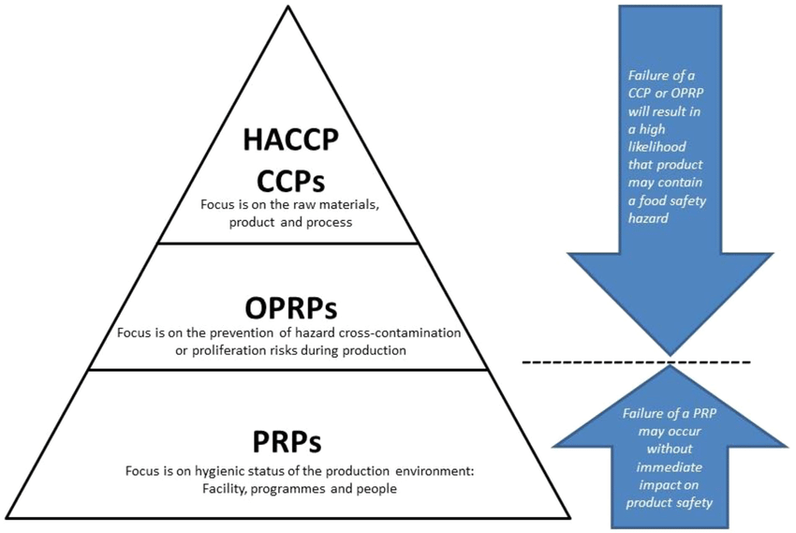

Slide 63
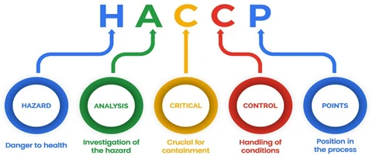

Slide 64
FATTOM
Food, Acidity, temperature, Time, Oxygen, Moisture Content
Monitoring – present
Verification – past
Validation - future

Slide 65
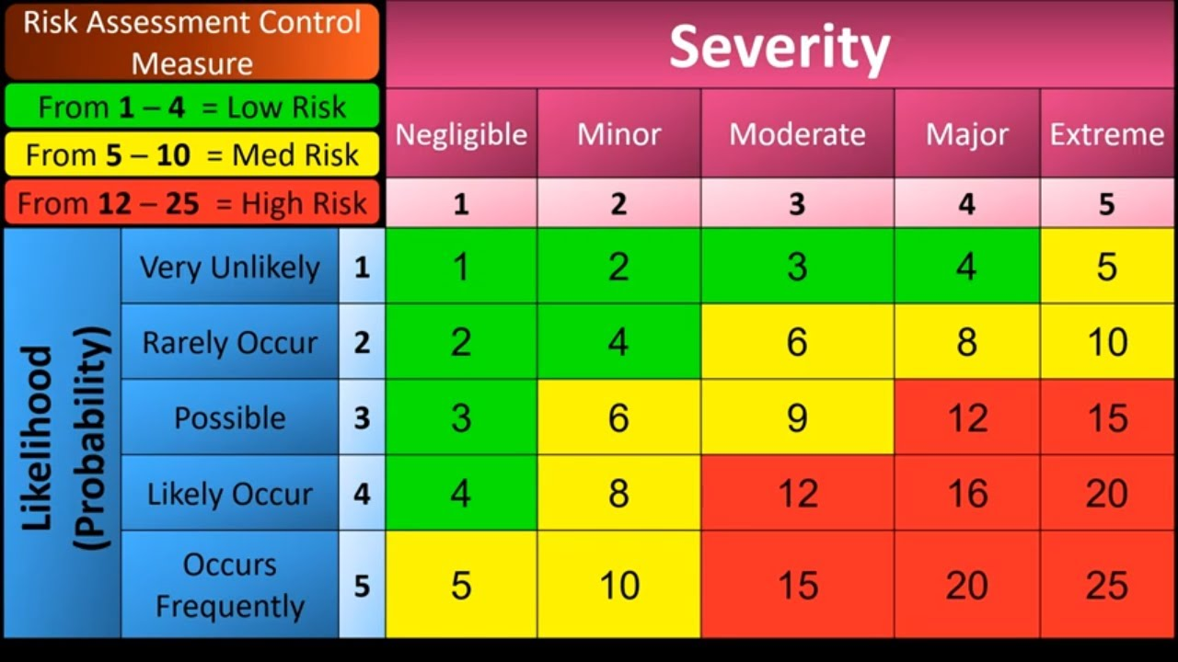

Slide 66
FSSAI ACT 2006 Rules 2011
Repealed Acts/Orders/Regulations
Prevention of Food Adulteration Act,1954
Fruit Products Order (FPO), 1955
Solvent Extracted Oil, De-oiled Meal and Edible Flour (Control) Order, 1967
Meat Food Products Order (MFPO) DIVISION, 1973
Vegetable Oil Product Order, 1980
The Edible Oils Packaging ( Regulation ) Order 1998.
Milk and Milk Product Amendment Regulations, 2009

Slide 67
Food Safety and Standards Regulations
Food Safety and Standards (Licensing and Registration of Food Businesses) Regulation, 2011
Food Safety and Standards (Food Products Standards and Food Additives) Regulation, 2011
Food Safety and Standards (Prohibition and Restriction of Sales) Regulation, 2011
Food Safety and Standards (Packaging and Labelling) Regulation, 2011
Food Safety and Standards (Contaminants, Toxins and Residues) Regulation, 2011
Food Safety and Standards (Laboratory and Sampling Analysis) Regulation, 2011

Slide 68
Food Safety and Standards Regulations…contd
Food Safety and Standards (Food or Health Supplements, Nutraceuticals, Foods for Special Dietary Uses, Foods for Special Medical Purpose, Functional Foods and Novel Food) Regulations, 2016
Food Safety and Standards (Food Recall Procedure) Regulation, 2017
Food Safety and Standards (Import) Regulation, 2017
Food Safety and Standards (Approval for Non-Specified Food and Food Ingredients) Regulations, 2017
Food Safety and Standards (Organic Food) Regulation, 2017
Food Safety and Standards (Alcoholic Beverages) Regulation, 2018
Food Safety and Standards (Fortification of Food) Regulation, 2018
Food Safety and Standards (Food Safety Auditing) Regulation, 2018

Slide 69
Food Safety and Standards Regulations…contd
Food Safety and Standards (Recognition and Notification of Laboratories) Regulation, 2018
Food Safety and Standards (Advertising and Claims) Regulation, 2018
Food Safety and Standards (Packaging) Regulation, 2018
Food Safety and Standards (Recovery and Distribution of Surplus food) Regulation, 2019
Food Safety and Standards (Safe food and balanced diets for children in school) Regulations, 2020
Food Safety and Standards (Foods for Infant Nutrition) Regulations, 2020
Food Safety and Standards (Labelling and Display) Regulations, 2020

Slide 70
Food Safety officer
a degree in Food Technology or Dairy Technology or Biotechnology or Oil Technology or Agricultural Science or Veterinary Sciences or Bio-Chemistry or Microbiology or Masters Degree in Chemistry or degree in medicine from a recognized University, or (ii) any other equivalent/recognized qualification notified by the Central Government, and (iii) has successfully completed training as specified by the Food Authority in a recognized institute or Institution approved for the purpose. Provided that no person who has any financial interest in the manufacture, import or sale of any article of food shall be appointed to be a Food Safety Officer under this rule

Slide 71
Food Analyst
Holds a Master’s degree in Chemistry or Biochemistry or microbiology or Dairy Chemistry or Food Technology, Food and Nutrition or holds Bachelor of Technology in Dairy/Oil or holds degree in Veterinary Sciences from a university established in India by law or is an associate of the Institution of Chemists (India) by examination in the section of Food Analysts conducted by the Institution of Chemists (India) or any other equivalent qualification recognized and notified by the Central government for such purposes and has not less than three years experience in the analysis of food; and

Slide 72
. The manuals of the method of analysis, as amended/adopted by the Authority from time to time including AOAC/ ISO/ Pearson’s/ Jacob/IUPAC/Food Chemicals CODEX/BIS/Woodmen/Winton-Winton/Joslyn, shall be used for analyzing the samples of food articles.
However, in case the method for analyzing any parameter is not available in these manuals, a validated method of analysis prescribed by internationally recognized/analytical/regulatory agencies, shall be adopted

Slide 73
RAFT (Rapid Analytical Food Testing)
The rapid food testing kit/equipment approved by FSSAI is to be used for screening and surveillance purposes only.
The purpose of the approval by FSSAI to Rapid Analytical Food Testing (RAFT) Kit/Equipment/Method is to facilitate carrying out on the spot field testing by Food Safety Officers (FSOs) or Mobile Testing Labs or to improve speed and reduce testing costs in food laboratories. The rapid food testing kit/equipment/method ensure “faster, better, cheaper” real-time testing of food. The rapid food testing kit/equipment/ method are better in terms of their size, faster in terms of their total run time and cheaper in terms of cost effectiveness as compared to conventional methods.
The recommended rapid kit/equipment/method meets the requirements of the Food Safety and Standard Regulations and are validated against International Standards.
The procedure for approval of Rapid Analytical Food testing Kit, Equipment or Methods shall be as per the guidelines that may be framed by the Food Authority from time to time.

Slide 74
Hazard Analysis table
Processing Step | Hazard |  |  |  | Risk analysis |  | Control measures | Significance
 | P | C | B | Details of hazard | Likelihood Occurrence | Severity impact |  | Signi ficant | Non Sig

Slide 75
CCP plan
Proc. Step | CCP | Critical Limit | Monitoring |  |  |  | Corrective Action | Record
 |  |  | What | How | When | Who

